Slide 1
Mr. Ulcena
6th - 8th Math
Week at a Glance 10/25-10/29

Slide 2
Welcome back to school class of 2021-2022
WAG=WEEK AT A GLANCE
Week at a glance (WAG) is designed to give parents a brief idea of what their child is learning at school. It will have the subject standards (Georgia Standards of Excellence), the main topics covered, links to videos and worksheets.
We encourage parents to review this presentation and stay informed on the weekly learning objectives.
WAGS are subject to change according to student mastery.

Slide 3
Math standards
6th Grade
Unit 3B
One-Step Equations and Inequalities
Priority Standards
6.EE.7
6.EE.8
6.EE.9a-b
Big Ideas:
Write and solve one-step equations and inequalities (6.EE.7-8).
Represent and analyze the relationship of dependent and independent variables with tables, graphs, words, and, equations.
7th Grade
Unit 2
Expressions and Equations
Priority Standards
7.EE.1
7.EE.3
7.EE.4a, b, & c
Big Ideas:
Use properties to add/subtract/factor/expand expressions and equations.
Solve multi-step real-world problems and mathematical problems using numerical and algebraic expressions and equations (EE.3-4)
Vocabulary:
Expressions, Equations
8th Grade
Unit 1
Exponents and Equations
Priority Standards
8.EE.4
8.EE.7a-b
8.NS.2
Big Ideas:
Add, subtract, multiply, and divide numbers expressed in scientific notation.
Analyze and solve multi-step linear equations.
Use rational approximation of irrational numbers to compare and locate on a number line and estimate value of expressions.

Slide 4
Monday 6th Grade Write and solve one-step equations and inequalities (6.EE.7-8). 7th Grade Use properties to add/subtract/factor/expand expressions and equations. Solve multi-step real-world problems and mathematical problems using numerical and algebraic expressions and equations PowerPoint presentation/Note taking 8th Grade Add, subtract, multiply, and divide numbers expressed in scientific notation. | Tuesday 6th Grade Write and solve one-step equations and inequalities (6.EE.7-8). 7th Grade Use properties to add/subtract/factor/expand expressions and equations. Solve multi-step real-world problems and mathematical problems using numerical and algebraic expressions and equations PowerPoint presentation/Note taking 8th Grade Add, subtract, multiply, and divide numbers expressed in scientific notation. | Wednesday Small Group/Remediation | Thursday Prodigygame.com– ALL grade level | Friday Assessment/ PBIS (Positive Behavioral Interventions and Support program)

Slide 5
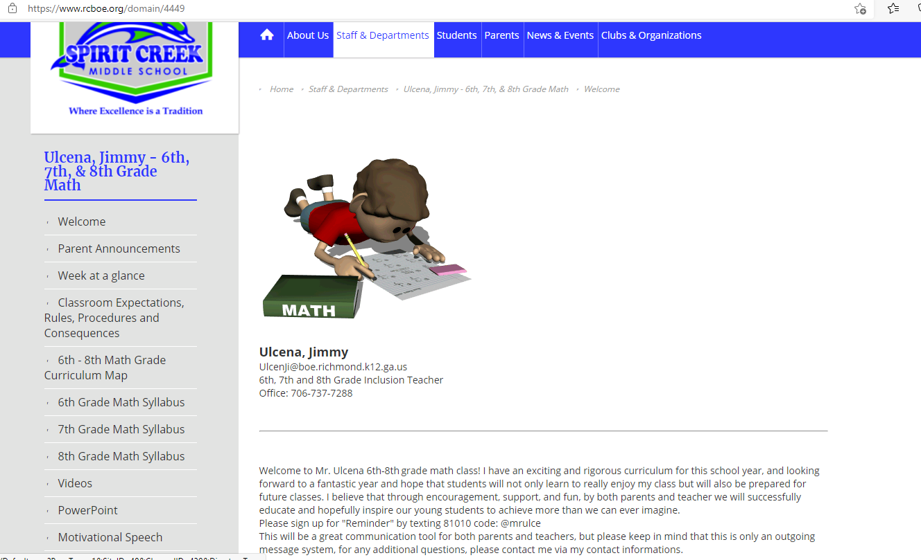

math Resources
For additional resources and weekly PowerPoint and videos click on link to Mr. Ulcena Teacher’s Page
https://www.rcboe.org/domain/4449
Khan Academy
https://www.khanacademy.org/

